Slide 1
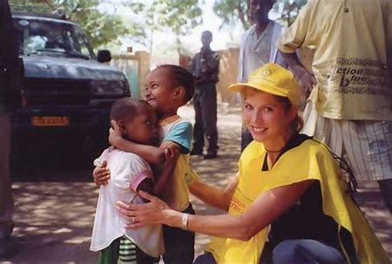
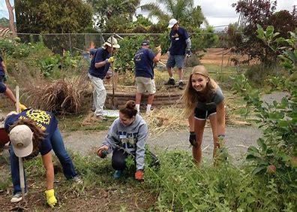
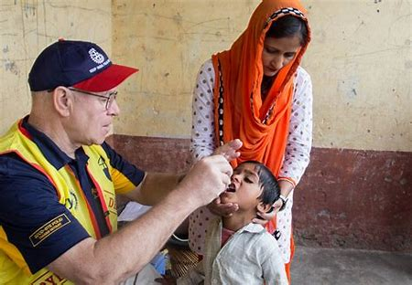

DISCOVER ROTARY
We are People of Action
Notes:
WELCOME to the Rotary Club of Randolph DISCOVER ROTARY EVENT!
Thank you for taking your valuable time to be with us today!
I name is Charles Allen. I’m the Membership Chair of the Rotary Club of Randolph, a Past Club President having served in 1999-2000 and a Past District Governor having served as DG in 2008-2009.
My career includes owning and operating a contract manufacturing company, Allen Precision Industries, Inc from 1980 until 2006 and supporting the development of Allen Machine & Fabrication since 2009 while my son and grandson and granddaughter lead the growth of this business.
I joined Rotary in 1993 for Networking Opportunities with the business professionals in Asheboro, NC. but the Rotary Friends, Fellowship and an amazing Network of Service opportunities in our community and around the world have kept me in Rotary for these past 31 years.

Slide 2
WELCOME
&
INTRODUCTIONS
Your Name:
Your Vocation (or past, if retired):
Members: "What attracted you to Rotary, and what's kept you in Rotary?“
Guests: What sparked your interest to attend this DISCOVER ROTARY EVENT today?
Notes:
INTRODUCTIONS:
I’ve just shared with you my Name, Vocation and why I joined Rotary and Why I stay in Rotary.
I would like each of our Rotarians to share in about 30 seconds the following:
Your Name:
Vocation (or past, if retired):
"What attracted you to Rotary, and what's kept you in Rotary?“
Now, I would like our Guests to share with us:
Your Name:
2. Vocation (or past, if retired):
3. What sparked your interest to come to this DISCOVER ROTARY EVENT TODAY?
You are here today because you were invited, but you may asking,
“What is Rotary?”

Slide 3
OBJECTIVES
Who We Are
What We Do
Impact in the Community
Notes:
OBJECTIVES
I think it best to answer that question by telling you:
Who We Are!
What We Do!
And Sharing with you
The Benefits of Being a Rotarian

Slide 4
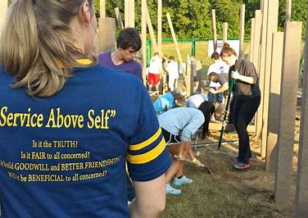
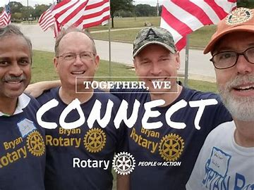
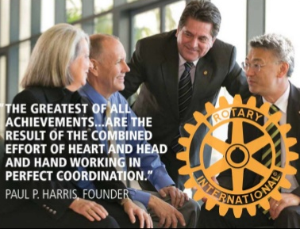
Rotary
Who We Are
1.4 million neighbors, friends, leaders, & problem solvers
in 46,000 + Clubs, in 220 + Countries
“Service Above Self”
Notes:
ROTARY – WHO WE ARE
Rotary is a membership organization and SERVICE is our Product to our communities locally and around the world.
We are a global network of 1.4 million neighbors, friends, business leaders, and problem solvers in over 46,000 clubs in over 220 countries around the world.
We do humanitarian service projects and encourage high ethical standards while striving for goodwill and peace in the world.
Our motto is “Service Above Self”.

Slide 5
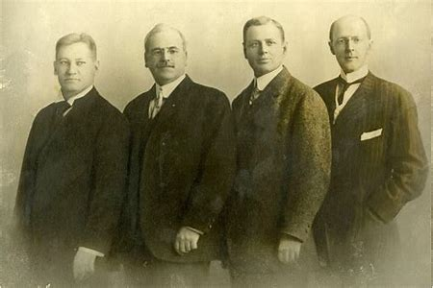
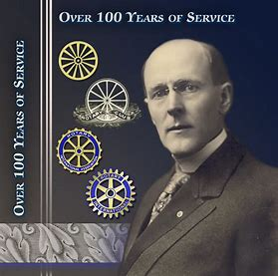
Who We Are
From left: Gustavus Loehr, Silvester Schiele, Hiram Shorey and Paul Harris.
Paul Harris
The first Rotary Club was organized in 1905, by Chicago Attorney Paul Harris.
Notes:
Who We Are!
ROTARY HAS A 119 YEAR HISTORY OF SERVICE.
In 1905 Paul Harris, an attorney in Chicago gathered 3 friends & business associates for Networking, Fellowship and Relationship Building.
Meetings were rotated from office to office and that’s how Rotary got its name.

Slide 6

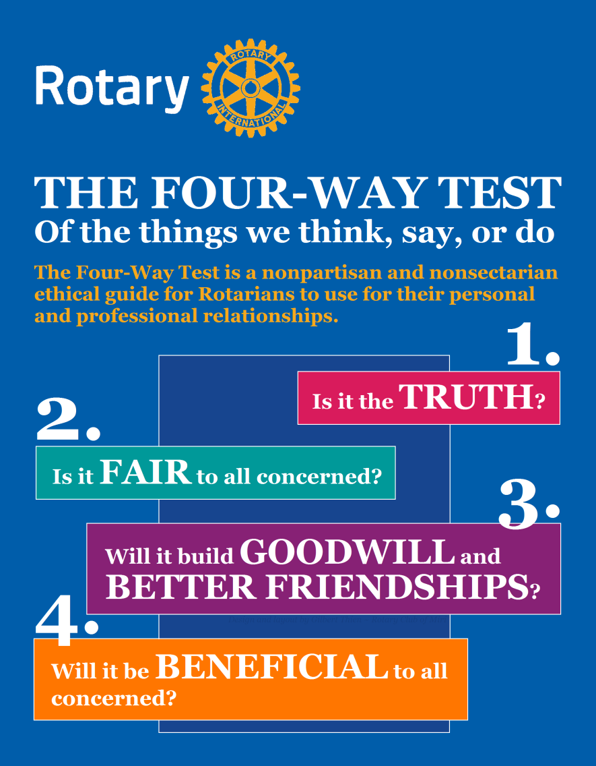
Who We Are
Rotary’s Core Values & THE FOUR-WAY TEST
Notes:
Who We Are!
Rotary’s Core Values of INTEGRITY, FELLOWSHIP, LEADERSHIP , DIVERSITY AND SERVICE have continued since Rotary was founded in 1905.
Since 1932 The Four Way Test Of the Things We Think, Say, or Do has been used by Rotarians as the standard in business ethics and personal relationships that can be applied every aspect of life by asking four simple questions…
Is it the TRUTH,
Is it FAIR to all concerned,
Will it build GOODWILL and BETTER FRIENDSHIPS,
Will it be BENEFICIAL to all concerned.

Slide 7






What We Do!
Notes:
WHAT WE DO!
TOGETHER, WE: FIGHT HUNGER, CONNECT, INSPIRE, TRANSFORM, BUILD WELLS, Work to END POLIO!
We are the largest, most financially sound membership organization
whose logo is recognized in more countries than any other in the world.
Every minute of every day We Feed, House, Vaccinate, Educate, Advocate,
Comfort and Provide Services in our communities locally and around the world!

Slide 8


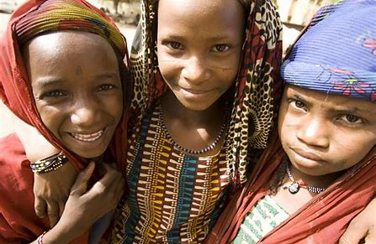

The Rotary Foundation
Notes:
Rotary’s non-profit foundation, The Rotary Foundation focuses on “Doing Good in the World” as it promotes world understanding and peace.
It has received from CHARITY NAVAGATOR their highest rating of Four Star for 15 consecutive years.
It has earned this recognition for adhering to sector best practices and executing its mission in a financially efficient way, demonstrating both strong financial health and commitment to accountability and transparency.
Since it was founded at the 1917 Convention, more than 107 years ago, the Foundation has spent more than $4 billion on life-changing, sustainable projects that support our Seven (7) Causes.

Slide 9

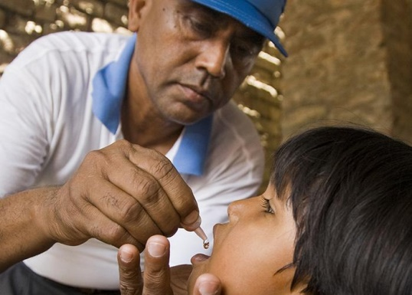

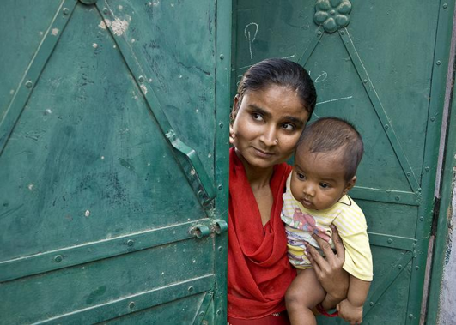



Our Causes
Promoting Peace
Fighting Disease
Providing Clean Water, Sanitation & Hygiene
Saving Mothers & Children
Supporting Education
Growing Local Economies
Protecting the Environment
Notes:
Rotary is dedicated to causes that build international relationships, improve lives, and create a better world to support our peace efforts and end polio forever.
All are critical humanitarian issues Rotarians have been working on for many years.
Our Seven (7) Causes:
Promoting Peace Fighting Disease
Providing Clean Water, Sanitation & Hygiene Saving Mothers & Children
Supporting Education Growing Local Economies
Protecting the Environment

Slide 10



Notes:
Rotary has been working to eradicate polio for more than 35 years. Our goal of ridding the world of this disease is closer than ever & END POLIO NOW is Rotary’s #1 PRIORITY.
As a founding partner of the Global Polio Eradication Initiative, we've reduced polio cases by 99.9 percent since our first project to vaccinate 6 million children in the Philippines in 1979.
Rotary members have contributed more than $2.1 billion and countless volunteer hours to protect nearly 3 billion children in 122 countries from this paralyzing disease.
Rotary’s advocacy efforts have played a role in decisions by governments to contribute more than $10 billion to the effort.
Today, the wild polio virus remains endemic in only Afghanistan and Pakistan with only six cases in Afghanistan and six cases in Pakistan in 2023. But it’s crucial to continue working to keep other countries polio-free.
If all eradication efforts stopped today, within 10 years, polio could paralyze as many as 200,000 children each year.
Polio Plus was launched in 1985 and has resulted in a 99.9% reduction in the number of Polio cases world-wide.
The Bill & Melinda Gates Foundation joined Rotary in 2017 a commitment of $450 million to help End Polio.

Slide 11
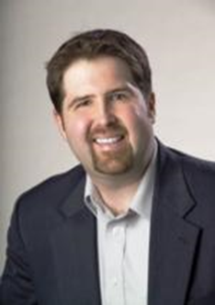

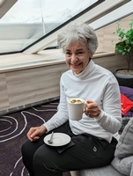
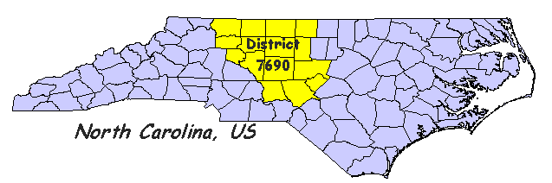
Rotary International District 7690
Rotary Club of Western Forsyth
Founded July 9, 2008
Service is our Core Value
Local and Global Projects
2024-25 District Governor
Ron Pierce
2024-25 Club President
Andrea Misel
Notes:
The Rotary Club of Kernersville is one of 47 clubs in District 7690 that includes 15 counties in Piedmont North Carolina.
Our 2024-25 District Governor is Ron Pierce, a member of the Rotary Club of Guilford since 2010.
The Rotary Club of Kernersville was sponsored by the Rotary Club of the Triad 37 Years ago with 22 Charter Members on November 24, 1987 and is a club with 84 active members. In addition, The Rotary Club of Kernersville chartered a satellite club, the Satellite Club of Kernersville Evening, on February 6, 2023. The club meets on the 3rd Thursday of the month at 6pm at J Peppers and has 13 active members.
We have three types of membership: Active Active-Service Choice Active – Primary & Alternate Corporate
Our 2023-2024 President is Chris L. Yow, a member since 1990.

Slide 12
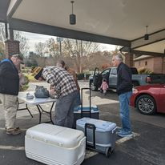
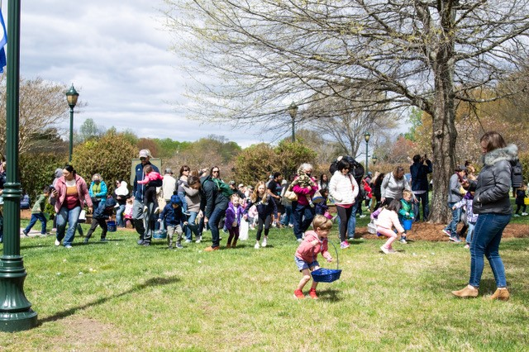
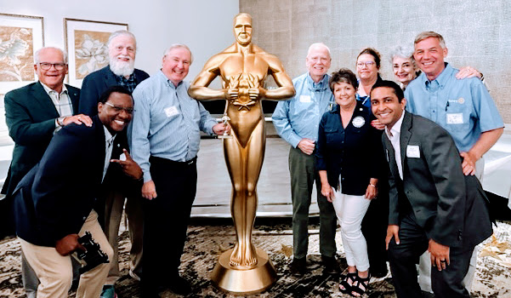
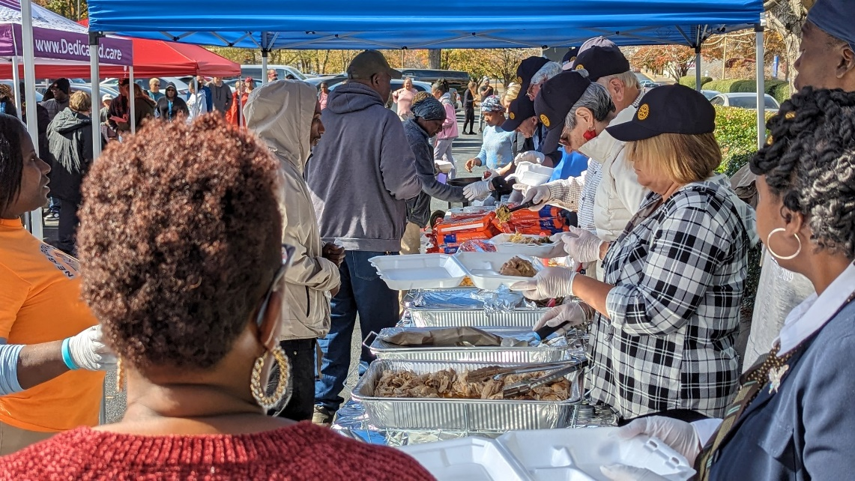
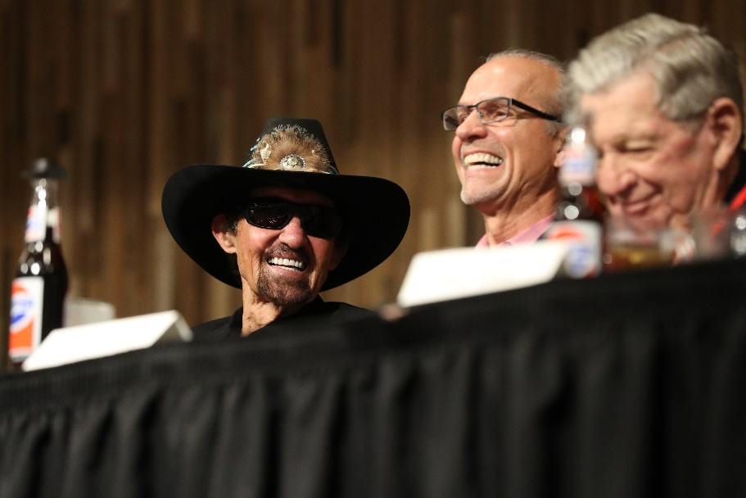
The Rotary Club of Western Forsyth
Projects:
Spring Eggstravaganza
BBQ Butts
Fundraiser
Comedy Roasts
Neighborhood’s Hands Thanksgiving & Christmas Food Distribution
Notes:
Randolph Rotary is involved in many Projects in our Community :
HAPPY FEET – A Pre- school project to furnish shoes and Backpacks with School Supplies to children in our community.
Dictionaries for 3rd Graders – A Partnership with the four (4) Rotary Clubs in Randolph County to furnish Dictionaries for every third grade class in the Asheboro City and Randolph County Schools.
BackPack Pals Meal Packing – Partnership with Communities in Schools and the SWRH & Uwharrie Charter Academy Interact Clubs to provide BackPack Pals Meals for children.
Sponsorship of High School Interact Clubs at Southwest Randolph County High School and Uwharrie Charter Academy High School
Annual Drawdown Fundraiser to raise $ 12-15 Thousand dollars annually to support multiple Non-profit organizations in our county, scholarships for High School Students and Rotary Youth Leadership Academy Summer Program Scholarships.

Slide 13


Why Join Rotary
Friendship, Relationship Building
Service to our Community
Professional Networking
Leadership Development
Personal Growth
Be part of something larger than yourself
Just a few of the reasons millions of people joined Rotary during the past 119 years
Notes:
There are many good reasons to join Rotary.
Life-long friends, Service to the community, networking, leadership development , personal growth, and, being part of something larger than yourself
These are just a few of the reasons why millions of people have joined Rotary over the past 119 years.
Rotary celebrated 119 years of service on February 23rd, 2024.

Slide 14
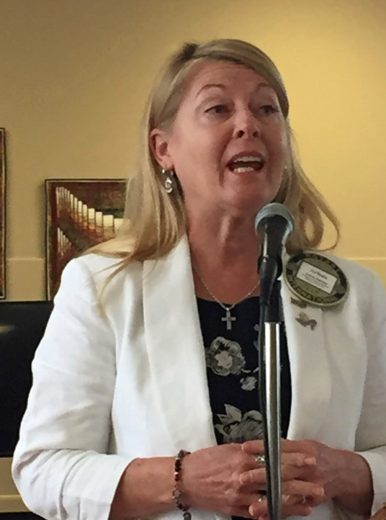
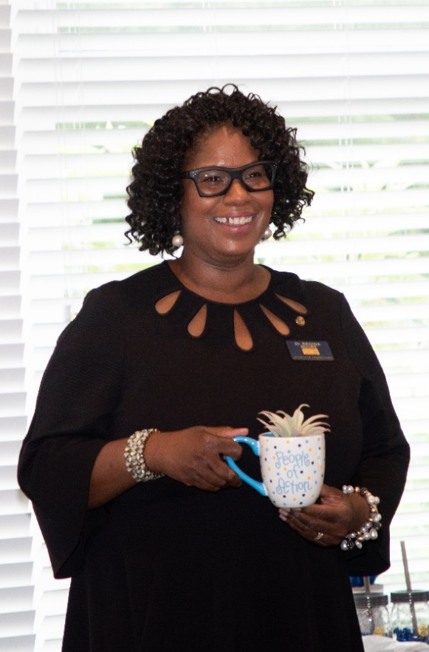
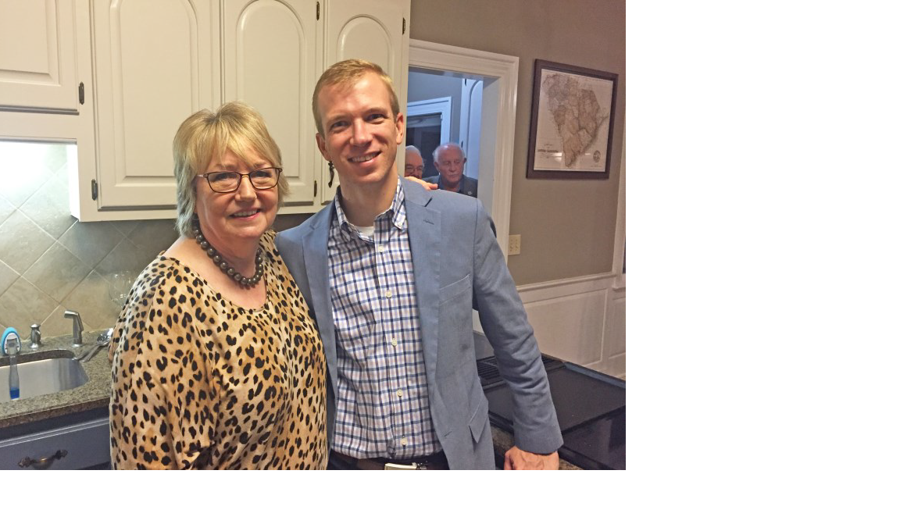
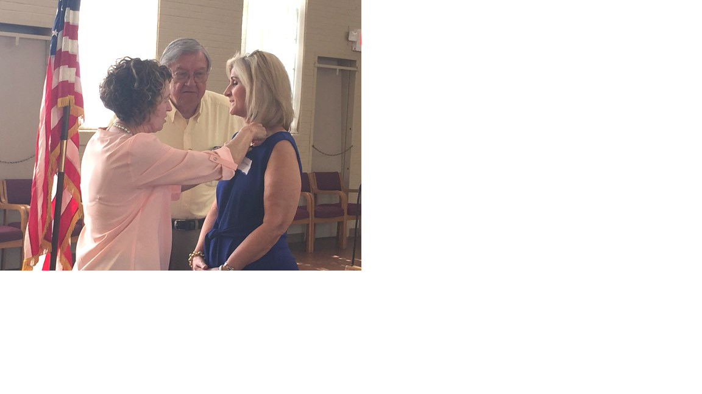
How To Join Rotary
New members become quickly involved in club activities, events, and consider leadership positions.
Notes:
There is a process for joining the Rotary Club of Randolph.
A Member asked you to attend a Discover Rotary Event and/ or three Rotary Club Meetings, Service Projects, Networking and Socials or Fundraising Events.
Membership is by invitation from a Rotarian.
You submit a completed membership proposal form and when the board of directors approves your membership, you are inducted into the club.
You must attend the new member orientation training and select a committee for service.
But most important of all…you become quickly involved in club activities and events and eventually we encourage all new members to consider a leadership position in the club.

Slide 15
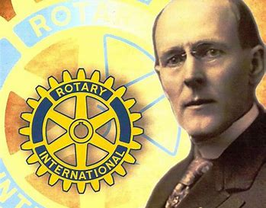


“If you have the love of your fellow men in your heart, my friend, you are a potential Rotarian.”
Notes:
Paul Harris said it best when describing what it takes to be a Rotarian when he said,
“If you have the love of your fellow men in your heart, my friend, you are a potential Rotarian.”

Slide 16

Thanks for your interest in the Rotary Club of Western Forsyth!
Notes:
ROTARY
TOGETHER WE SEE A WORLD
WHERE PEOPLE UNITE AND TAKE ACTION
TO CREATE LASTING
CHANGE ACCORSS THE GLOBE
IN OUR COMMUNITIES AND IN OURSLEVES.
Thanks for your interest in the Rotary Club of Randolph!

Slide 17
Questions ?

